Slide 1



SEEC: Stochastic Escape Express Channel
Supercomputing 2021
November 16, 2021
¹Georgia Tech
²Univ of Toronto
³Texas A&M
⁴Univ of Wisconsin
Mayank Parasar¹, Natalie Enright Jerger², Paul V. Gratz³, Joshua San Miguel⁴, Tushar Krishna¹
https://github.com/noc-deadlock/seec
¹
Presented By:
Tushar Krishna
Associate Professor
School of ECE
Georgia Institute of Technology
Email: tushar@ece.gatech.edu
November 16, 2021
Email: tushar@ece.gatech.edu

Slide 2
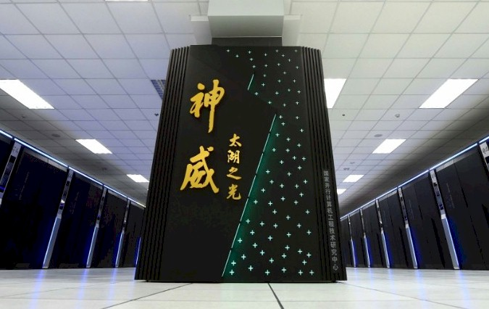
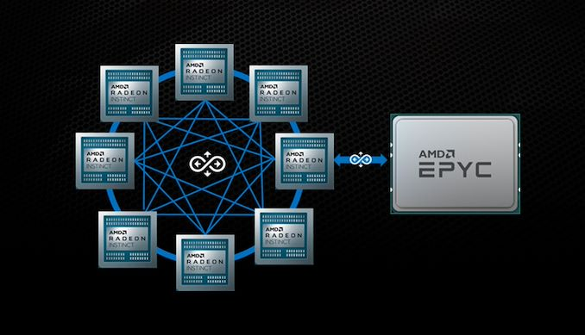
Interconnection Networks are at the heart of HPC
This work focuses on interconnection networks-on-chip (aka NoCs)

Slide 3
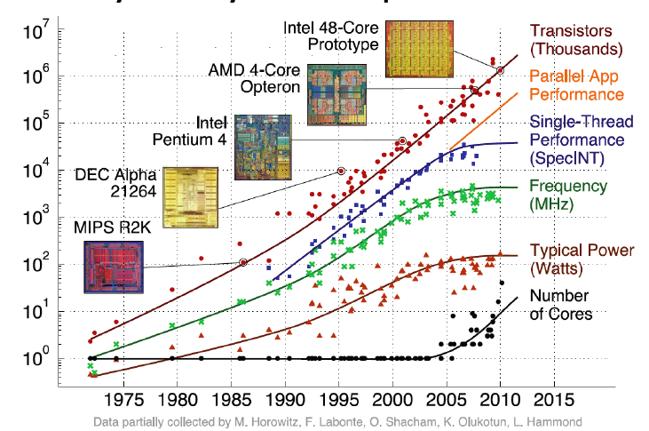
Why do we need Networks-on-Chip?
Power Wall
Many Core
Communication
Network-on-Chip

Slide 4
Network-on-Chip 101
Topology
How to connect the nodes
~Road Network
Routing
Which path should a message take
~Series of road segments from source to destination
Flow Control
When does the message have to stop/proceed
~Traffic signals at end of each road segment
Router Microarchitecture
How to build the routers
~Design of traffic intersection (number of lanes, algorithm for turning red/green)
Design-time hardware-managed topology, routing and flow-control decisions makes networks-on-chip different from larger scale HPC / datacenter networks

Slide 5
Challenges with NoC Design
9
10
1
Correctness → Guaranteed packet delivery
No Routing Deadlocks
No Protocol Deadlocks
Performance → Deliver as many packets as fast as possible
Reduce Latency
Increase Throughput
8
Deadlock
Challenge: Cyclic dependence
7
5
6
14
1
4
0
Challenge: Congestion
5
0
0
0
0
0
This work addresses both challenges with a unified solution
1
0
3
0

Slide 6
Outline
Background
Networks-on-Chip
Deadlock-Freedom Techniques
SEEC
Overview
Walkthrough
Features
Optimizations
Evaluations
Conclusions

Slide 7
What are deadlocks?
A condition in which a set of agents wait indefinitely trying to acquire a set of resources

Slide 8
Two kinds of deadlocks
Cache
Destination Router-5
Injection queue
Ejection queue
Network
6
5
Finite Network Buffers
Request Packets
9
10
Deadlock
5
Network
Deadlock
Network
5
6
10
Protocol Deadlocks
Response Packet
9
Directory
Network
Routing Deadlocks
Buffers occupied by the request packets renders forward movement of response packet impossible

Slide 9
Current solutions for deadlock-freedom
Proactive Techniques
Avoid deadlock to begin with
Reactive Techniques
Allow deadlocks to form in the network
Detect deadlocks and recover from them
Add turn restrictions or provide additional virtual lanes/channels
Add circuitry for monitoring and identifying cyclic dependencies at runtime
Notes:
We have classified the prior proposed techniques in following two categories:
Proactive Techniques: These techniques avoid the deadlock in the network to begin with
Reactive Techniques: These techniques allows the deadlock in the network. They detects the deadlock and then recovers from it.

Slide 10

Example of proactive routing deadlock-freedom
Destination Router-5
Add turn restrictions
Network
Network
5
9
10
9
10
5
6
9
9
Network
Deadlock
Network
Network
X
Network
5
5
6
6
5
6
10
10
Network
Network
Routing Deadlocks

Slide 11
Example of proactive protocol deadlock-freedom
Cache
Cache
Dedicated Separate Queues (aka Virtual Networks)
Injection queue
Ejection queue
Finite Network Buffers
Request Packet
Deadlock
Response Packet
Directory
Directory
Protocol Deadlocks

Slide 12


Deadlock-Freedom Techniques
Technique | Type of Solution | High Throughput | Low Area Power | Low Hardware Complexity | Routing Deadlock-free | Protocol Deadlock-free
Turn Restriction [1] | Proactive
Escape VC [2] | Proactive
Virtual Network [3] | Proactive
Deadlock Recovery [4] | Reactive
? | ??
Can we do better?
[1]:
Deadlock-free message routing in multiprocessor interconnection networks [IEEE Trans. Computer, 1987]
Takeaway:
Proactive techniques add performance and area overheads.
Reactive techniques require expensive monitoring circuitry
[2]:
A new theory of deadlock-free adaptive routing in wormhole networks. [IEEE Trans. On Parallel and Dist. Sys, 1993]
[3]:
The Alpha 21364 network architecture [MICRO 2002]
[4]:
DISHA [IPDPS’95] Static Bubble [HPCA’17] SPIN [ISCA’18]
Notes:
Deadlock is a well studied problem in interconnection networks, more than 4 decades of research has been done in this field. I am evaluating the previous proposed solutions on following metric
Weather the solution provides full path diversity?
If there are extra VCs used in the solution?
Is the solution works for a fixed topology?
Does the solution require expensive circuitry to detect and resolve deadlock?
--
Dally’s solution restricts certain turns that a packet can take in the network, so the packet is not involved in the deadlock, to begin with.
Because of turn restriction, a packet cannot utilize the full path diversity and it needs to know about the topology.
Duato’s theory proposes an acyclic escape path within the extended cyclic CDG of the network and every packet has access to this acyclic escape path to make the network deadlock-free. Acyclic escape path requires an extra set of buffers in the form of escape VC and escapeVC needs to know about the topology to make this escape path acyclic, and packet in the escape path cannot enjoy the full path diversity
Then there is work on restricting the injection of packets in the network such that deadlock never happens. This comes with an underlying theory that as long as there is a bubble or free VC present in the ring it will be deadlock-free.
This cannot provide full path diversity to the packet and this theory is tied to ring-like topology
Deflection routing keeps misrouting packets every cycle such that the packet never stays in the same buffer for more that one cycle. Because of which packet cannot utilize the full path diversity during congestion due to continued misrouting.
Then there is work on coordination, which detects and maps the deadlock during runtime using probes and timeouts and then synchronizes the movement of packets involved in the deadlock. This involves complicated deadlock detection circuitry.
As we can see there is no work which has all the favorable characteristics and we ask this question that can we come up with a technique which provides all these favorable characteristics

Slide 13

“Subactive” Techniques
Proactive Techniques
Avoid deadlock to begin with
Reactive Techniques
Allow deadlock to form in the network
Detect deadlocks and recover from them
Subactive Techniques
Allow deadlocks to form in the network
Obliviously flush network to remove any deadlock
Notes:
We introduce a new class of solutions called ”Subactive Techniques”
These techniques allows the deadlock in the network, but oblivious flushes the network to remove any deadlock which may be present.

Slide 14
Intuition behind Subactive
Deadlocks are rare!
Requires certain ensemble of packets with a particular buffer dependency for the deadlock to occur
A mechanism to ensure periodic draining of packets sufficient to guarantee deadlock-freedom
No need for proactive performance restrictions / additional reserved queues
No need for detection and reactive recovery
This work (SEEC) is one of many possible subactive solutions
See our other work: SWAP (MICRO 2019), DRAIN (HPCA 2020), PitStop (HPCA 2021)

Slide 15
Outline
Background
Networks-on-Chip
Deadlock-Freedom Techniques
SEEC
Overview
Walkthrough
Features
Optimizations
Evaluations
Conclusions

Slide 16


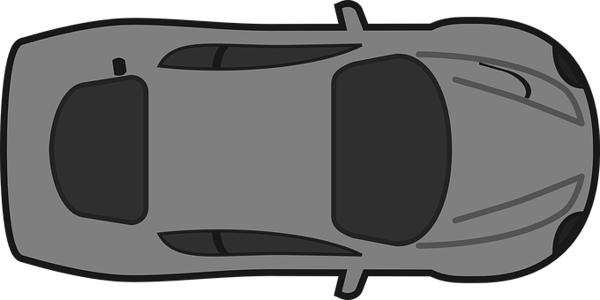

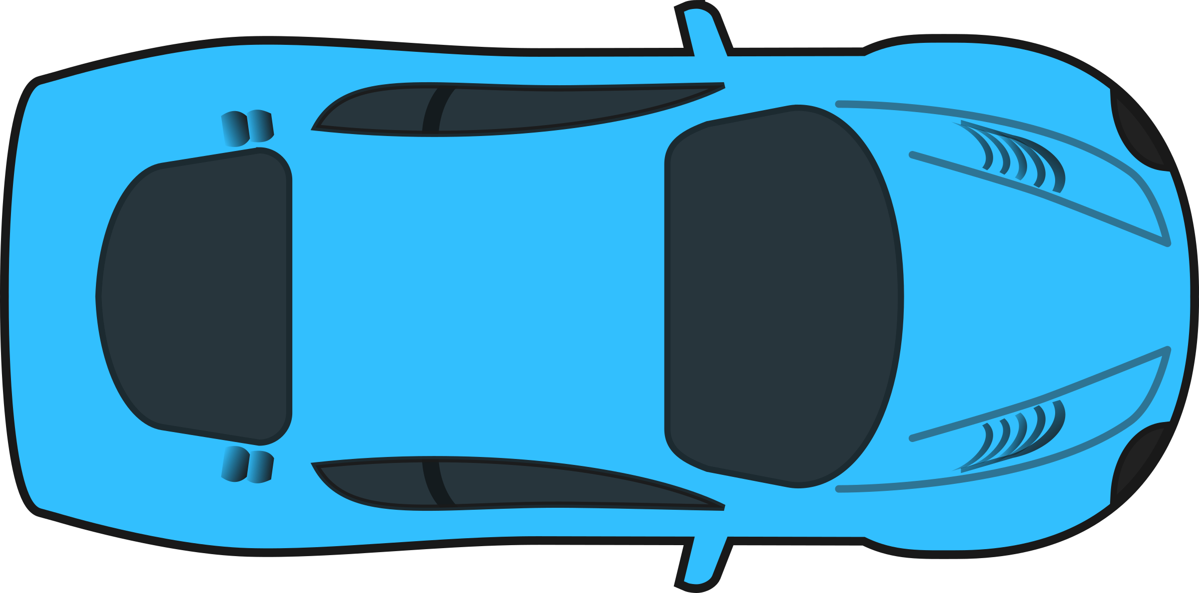
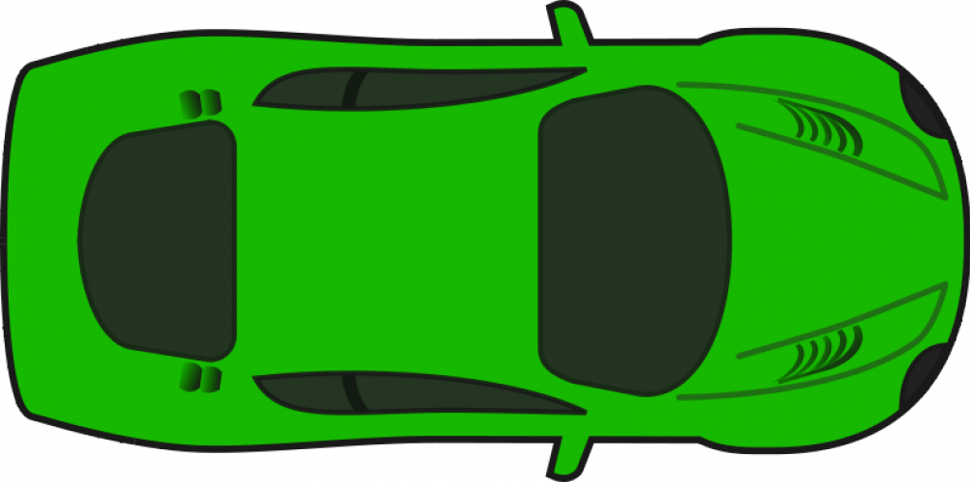
SEEC: Deadlock Analogy
Deadlock
Destination

Slide 17
SEEC: Walk-through for Deadlock-freedom
N
12
Reserve a free ejection buffer at the NIC
Send a seeker over a sideband seeker path through all routers
If a packet intended for this NIC is found, upgrade it for Free Flow (FF)
FF packet given priority over regular packets to traverse all the way to the N
Repeat for all NICs in round-robin manner
13
14
15
5
E
W
Destination Router-5
S
Upgrade to FF
8
9
10
11
1
Upgrade to FF
8
Deadlock
Seeker Path
4
7
5
6
7
14
0
1
2
3
Seeker
1
Seeker
Free Slot
NIC

Slide 18
Outline
Background
Networks-on-Chip
Deadlock-Freedom Techniques
SEEC
Overview
Walkthrough
Features
Optimizations
Evaluations
Conclusions

Slide 19
Features of SEEC
Novel Flow Control: Free Flow (FF)
Packets upgraded to FF via seeker
FF packet gets prioritized over the buffered packets
FF packet sends a lookahead signal on cycle in advance
lookahead signal sets the appropriate mux at downstream router
FF packet traverse the network from link to link till the NIC
FF packets follow minimal (shortest) express path with no buffering
SEEC proposes co-existence of FF packets and buffered packets
Seeker Path
Any pre-defined path that visits all routers
Separate sideband network
could use regular links by prioritizing seeker over regular packets
Possible to have multiple parallel seekers → later in talk

Slide 20
Router Microarchitecture
FF packet Bypass Path

Slide 21
Deadlock Freedom Proof
The ejection port at NIC has separate Virtual Networks (one per protocol message class)
The response packet can cause a protocol deadlock, if stuck in network
SEEC is protocol deadlock free as NIC will eject any blocked response packet by sending seeker
SEEC is routing deadlock free as all the input ports get chance to send packets via FF flow control
SEEC is livelock free as there is no misrouting

Slide 22
Mathematical upper bound for deadlock persistence
For any irregular network topology:
Assume diameter is D
Assume it takes on an average ‘k’ cycles at the ejection port
Number of nodes in the network is ‘N’
Let the average network router-radix of the router is ‘r’
The maximum time it takes for a deadlock to persist
Deadlock involves at least 4 routers
[{r*(N-4)*2*D*k} + (D+k)] cycles

Slide 23
SEEC: Additional Benefits → Performance
12
13
14
15
Blocked!
8
9
10
11
SEEC helps packets to bypass congestion in the network, improving performance
Upgrade to FF
1
4
0
5
6
7
0
0
0
Congestion
0
0
0
1
2
3
0
3
0
1
Seeker
NIC
Free Slot

Slide 24
Outline
Background
Networks-on-Chip
Deadlock-Freedom Techniques
SEEC
Overview
Walkthrough
Features
Optimizations
Evaluations
Conclusions

Slide 25
Multi-SEEC (mSEEC)
Motivation
Path Diversity in many topologies: Multiple ways of reaching a node
Features of mSEEC
Creates multiple FF packets that can traverse simultaneously
Requirement
Multiple FF packets traverse minimally without overlapping paths
Implementation
mSEEC divides the topology into independent regions

Slide 26
mSEEC: Walk Through
Phase 0
Seeker
Packet
Partition
0
1
2
0
1
2
0
1
2
Group-0
A
B
C
A
B
C
A
B
C
D
E
F
D
E
F
D
E
F
G
H
I
G
H
I
G
H
I
When Phase-0 finishes:
each node in group-0 has searched entire topology
Phase-1 starts

Slide 27
mSEEC: Walk Through
Phase 1
Seeker
Packet
Partition
0
1
2
0
1
2
0
1
2
A
B
C
A
B
C
A
B
C
Group-1
D
E
F
D
E
F
D
E
F
G
H
I
G
H
I
G
H
I
When Phase-1 finishes:
each node in group-1 has searched entire topology
Phase-2 starts and so on…

Slide 28
Outline
Background
Networks-on-Chip
Deadlock-Freedom Techniques
SEEC
Overview
Walkthrough
Features
Optimizations
Evaluations
Conclusions

Slide 29
Evaluations Methodology
gem5 for full system and synthetic simulations
Garnet2.0 for network simulation
SEEC/mSEEC uses minimal adaptive routing algorithm with full path diversity
Virtual Cut Through Buffer Management
Evaluated on 4x4 (16 nodes), 8x8 (64 nodes), and 16x16 (256 nodes) Mesh topology

Slide 30
Results: Performance Sweep
11% over subactive techniques
25% over prior work
30% over subactive techniques
40% over prior work
40% over subactive techniques
57% over prior work

Slide 31
Results: Throughput Enhancement
Uniform Random
XY Routing
Uniform Random
West First Routing
16% throughput improvement in 4x4 Mesh

Slide 32
Results: SEEC-%age of FF packets
Post saturation heavy reliance on FF for packet delivery

Slide 33
Results: Full System Simulation
mSEEC provides 37% lower packet latency compared to baseline Escape VC in 4x4 Mesh

Slide 34
Normalized Area and Static Power
~65% Lower Static Area
~70% Lower Static Power
Notes:
Major Area/power savings comes from lower buffer overhead.

Slide 35
Outline
Background
Networks-on-Chip
Deadlock-Freedom Techniques
SEEC
Overview
Walkthrough
Features
Optimizations
Evaluations
Conclusions

Slide 36
Conclusion
Deadlock is a correctness problem which every network must solve
Current solutions either require complex deadlock detection or provision extra set of buffers or restrict turns
SEEC provides a novel way of resolving deadlock by periodically moving packets for few hops along a ring constructed over the network.
No extra buffer needed
Free from complicated deadlock detection circuitry
Provides full path-diversity therefore high performant

Slide 37
Revisiting Qualitative Comparison
Codebase available here:
https://github.com/noc-deadlock/seec
Teechnique | Type of Solution | High Throughput | Low Area Power | Low Hardware Complexity | Routing Deadlock-free | Protocol Deadlock-free
Turn Restriction | Proactive
Escape VC | Proactive
Virtual Network | Proactive
Deadlock Recovery | Reactive
SEEC | Subactive
Takeaways
SEEC obliviously provides deadlock freedom
SEEC is completely decentralized
SEEC has low hardware overhead over baseline router
Thanks!
Notes:
Instead of citation put take away from DRAIN
Deadlock is a well studied problem in interconnection networks, more than 4 decades of research has been done in this field. I am evaluating the previous proposed solutions on following metric
Weather the solution provides full path diversity?
If there are extra VCs used in the solution?
Is the solution works for a fixed topology?
Does the solution require expensive circuitry to detect and resolve deadlock?
--
Dally’s solution restricts certain turns that a packet can take in the network, so the packet is not involved in the deadlock, to begin with.
Because of turn restriction, a packet cannot utilize the full path diversity and it needs to know about the topology.
Duato’s theory proposes an acyclic escape path within the extended cyclic CDG of the network and every packet has access to this acyclic escape path to make the network deadlock-free. Acyclic escape path requires an extra set of buffers in the form of escape VC and escapeVC needs to know about the topology to make this escape path acyclic, and packet in the escape path cannot enjoy the full path diversity
Then there is work on restricting the injection of packets in the network such that deadlock never happens. This comes with an underlying theory that as long as there is a bubble or free VC present in the ring it will be deadlock-free.
This cannot provide full path diversity to the packet and this theory is tied to ring-like topology
Deflection routing keeps misrouting packets every cycle such that the packet never stays in the same buffer for more that one cycle. Because of which packet cannot utilize the full path diversity during congestion due to continued misrouting.
Then there is work on coordination, which detects and maps the deadlock during runtime using probes and timeouts and then synchronizes the movement of packets involved in the deadlock. This involves complicated deadlock detection circuitry.
As we can see there is no work which has all the favorable characteristics and we ask this question that can we come up with a technique which provides all these favorable characteristics

Slide 38
Backup

Slide 39
Results: SEEC-Network Latency breakdown

Slide 40
Result: Max Packet Latency
mSEEC has the lowest max packet latency

Slide 41
Results: Subactive Techniques
We observe following performance order (subactive techniques only) : BBR < BINDU ≈ DRAIN ≈ SWAP < SEEC < mSEEC

